Slide 1
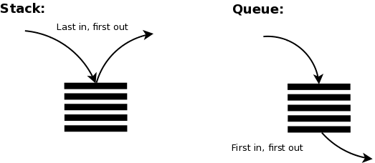
Interview Prep: Stacks and Queues
Samuel Bishop

Slide 2
Occupations Overview (“Software Engineer” job description can be any of these)

Slide 3
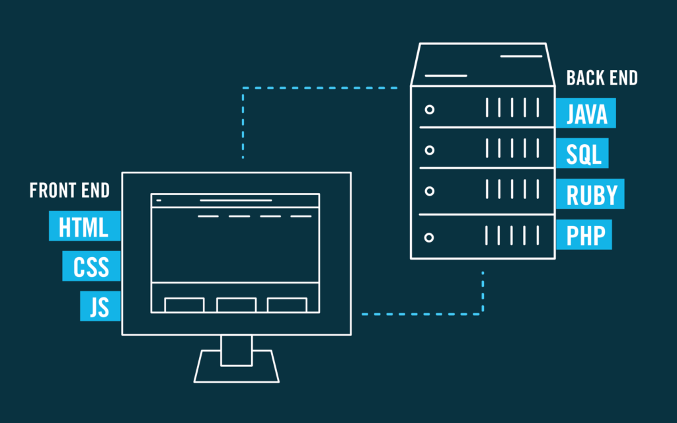
Web Development
Front End:
- Develops client-side program (HTML, CSS, JavaScript – Frameworks like React and Angular)
Back End:
- Develops server-side program (Machine running Apache or Nginx)
Database Engineer:
- Develops database infrastructure to communicate with backend
Full Stack:
- Jack of all trades. Knows a lot about all of this but is less specialized.

Slide 4
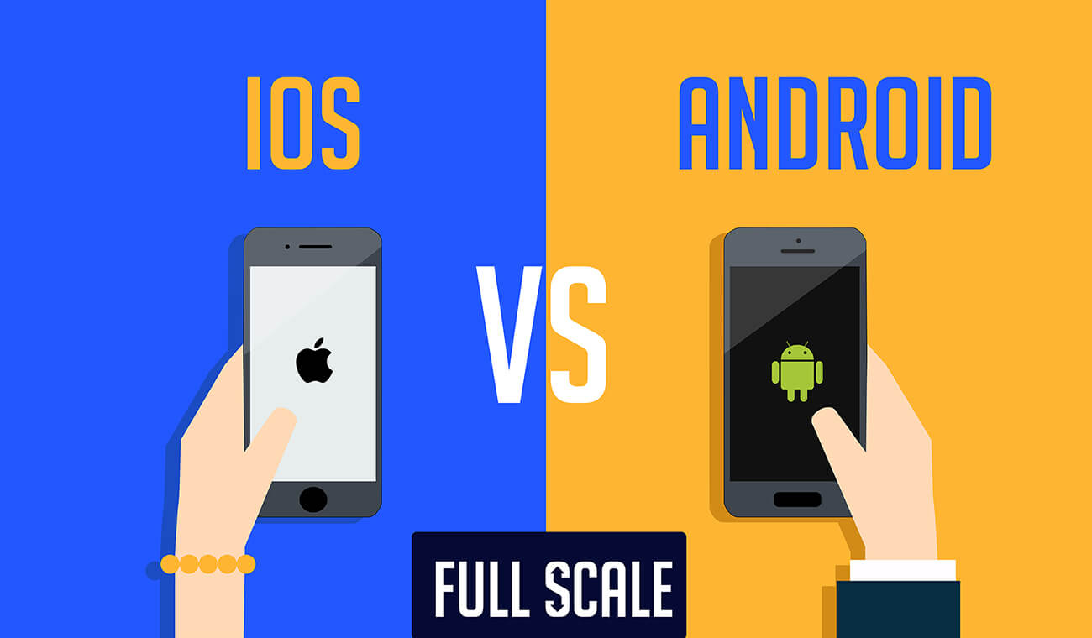
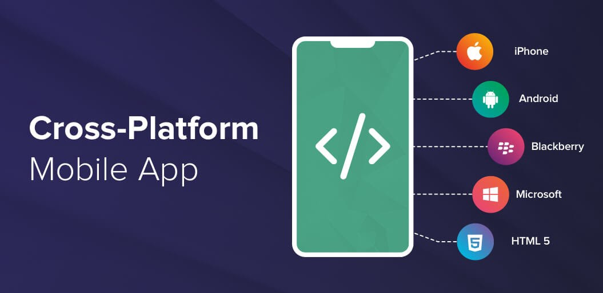
Mobile Development
- Same job descriptions as the last slide apply
Android:
- Develop using Java and Kotlin
iOS:
- Develop in Swift and Objective C
Cross Platform:
- Develop in React Native, Flutter, Xamarin

Slide 5

Desktop Development
- Pretty broad
- Work on a programming applications for desktop on any operating system, however the big three are Windows, Linux, and MacOS.
- Can use any programming language. Job specific.
- May use some of the same backend and database technologies as mobile developers.

Slide 6
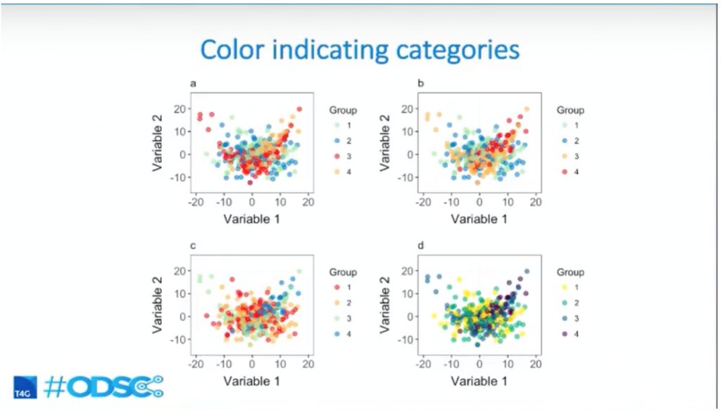
Data Science (Quantitative Analytics)
- Create programs to collect, analyze, and interpret large data sets
- Purpose of this job is to help businesses make informed decisions
- Knowledge of relational algebra as well as statistical techniques (regression, simulation, modeling, clustering)
- Often using Python and R
If you research in a university setting this is most likely what you will be doing

Slide 7
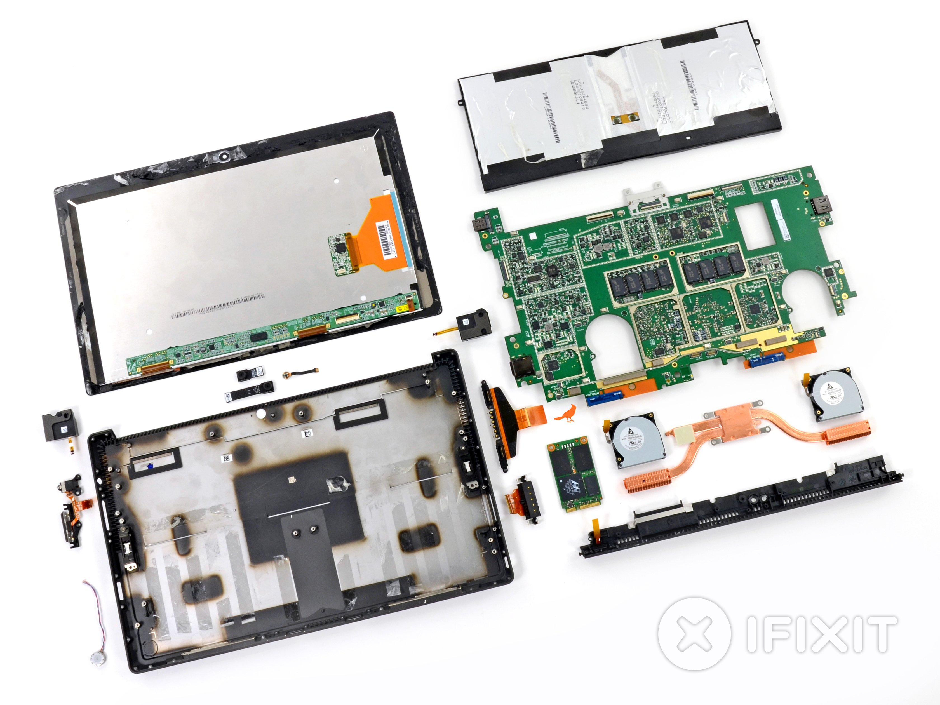
Hardware
Electrical Engineer/Design Engineer/Computer Architect;
- Designs circuitry/machine according to desired specifications (application specific)
Firmware Engineer/Embedded Engineer:
- Programs the constructed electrical device to be able to interface with other operating systems (interoperability).

Slide 8

Product Manager
- Product planning and execution
- Compiles specifications
- Manages documentation
- Must have at least a baseline technical knowledge
- Delegates tasks
- Determines pricing
Anything that doesn’t have to do with creating the software but requires attention

Slide 9
Coding Section

Slide 10
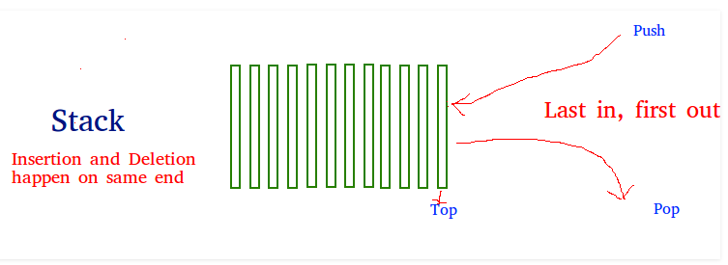
Stack (Data Structure)
Easy Data Structure
Allows O(1) time access when used correctly
Always O(N) space complexity to use this data structure
Last in first out (LIFO)
Stack Functions in Python:
empty() – Returns whether the stack is empty – Time Complexity : O(1)
size() – Returns the size of the stack – Time Complexity : O(1)
top() – Returns a reference to the top most element of the stack – Time Complexity : O(1)
push(g) – Adds the element ‘g’ at the top of the stack – Time Complexity : O(1)
pop() – Deletes the top most element of the stack – Time Complexity : O(1)

Slide 11
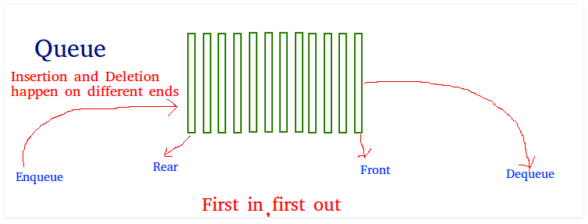
Queue (Data Structure)
Similar to stack but implemented with a front and rear
First in first out (FIFO)
Insertion and deletion happen at different ends
Queue functions in Python:
Enqueue: Adds an item to the queue. – Time Complexity : O(1)
Dequeue: Removes an item from the queue. The items are popped in the same order in which they are pushed.
– Time Complexity : O(1)
Front: Get the front item from queue – Time Complexity : O(1)
Rear: Get the last item from queue – Time Complexity : O(1)

